Slide 1
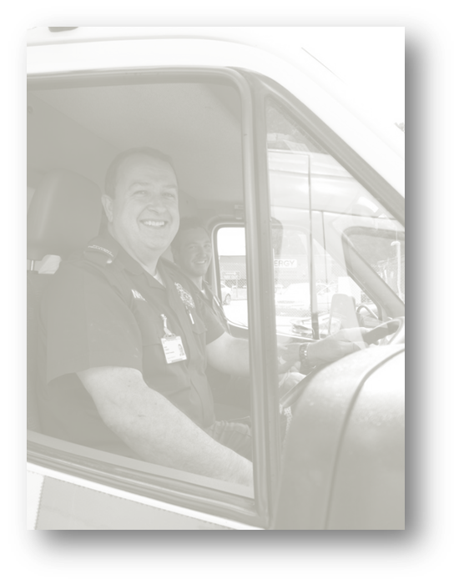
World Patient Safety Day Haemorrhage in obstetrics – Case presentation

Slide 2
Tasking
21 Haemorrhage (Gone Unconscious) – C1 response

Slide 3
On arrival
History:
From patient and partner: incomplete miscarriage 6 weeks ago (est 8 weeks gestation). ERPC 26/10/20. Bleeding started again this week. Significant PV bleed yesterday brought to ED. Discharged with TXA and plan for USS today. Bleeding started again at noon, heavy, painful cramping. Felt faint and sat on floor in bathroom. P1G2, 3 year old child in care of neighbour. Otherwise fit & well.
On EEAST arrival:
Est 500ml blood fresh and clots on bathroom floor. Patient alert. NOK present.

Slide 4
On examination
Patent, speaking
RR 32 chest clear, saturating well.
HR 112 BP 90/65 CRT 4seconds, radials present, no oedema. Thirsty and cold. Pallor. Ongoing PV bleed.
E3V5M6 moving all 4 limbs, orientated and appropriate. Cerebrally mentating.
Temp 36.5, abdomen soft, no injuries found.

Slide 5
Impression & Interventions
Impression:
Endometrial infection/retained products, significant blood loss with signs of hemodynamic compromise.
Minimal delay on scene.
Treatment en route:
Misoprostol 800mcg given sublingual at 14:35
TXA 1g
Pre-alert call requesting obs/gynae response
Analgesia and antiemetics offered - declined at present by patient
Second IVA sited

Slide 6
Clinical Best Practice Misoprostol

Slide 7
Clinical Best Practice Misoprostol

Slide 8
Clinical Best Practice Misoprostol

Slide 9
Clinical Best Practice Tranexamic Acid

Slide 10
Clinical Best Practice Tranexamic Acid

Slide 11
Clinical Best Practice Tranexamic Acid

Slide 12
References
JRCALC Guidelines 2019
EEAST Clinical Manual App 2020

