Slide 1
World Patient Safety Day 2021
Safe Maternal
and
Newborn Care

Slide 2
South Western Ambulance Service (SWAST)
SWAST has responsibility for the provision of ambulance services across an area of 10,000 square miles which is 20% of mainland England. The Trust covers the counties of Cornwall and the Isles of Scilly, Devon, Dorset, Somerset, Wiltshire, Gloucestershire, Bristol, Bath, Somerset.
The Trust serves a total population of over 5.5 million and is estimated to receive an influx of over 23 million visitors each year.
Emergency ambulance 999 services (A&E) are provided across 94 ambulance stations, two clinical control rooms, six air ambulance bases and two Hazardous Area Response Teams (HART).

Slide 3
Trust mission statement “To respond quickly and safely to patients’ emergency and urgent care needs, at every stage of life, to reduce anxiety, pain and suffering” Trust vision statement “Exceptional patient care delivered by exceptional people”
Trust values
Working together for patients
We put patients first in everything we do, by reaching out to staff, patients, carers, families, communities, and professionals inside and outside the NHS;
Respect and dignity
We value each person as an individual, respect their aspirations and commitments in life, and seek to understand their priorities, needs, abilities and limits;
Commitment to quality of care
We earn the trust placed in us by insisting on quality and striving to get the basics of quality of care – safety, effectiveness and patient
experience – right every time;
Compassion
We ensure that compassion is central to the care we provide and we respond with humanity and kindness to each person’s pain, distress, anxiety or need;
Improving lives
We strive to improve health and well-being and people’s experiences of the NHS;
Everyone counts
We maximise our resources for the benefit of the whole community, and make sure nobody is excluded, discriminated against or left behind

Slide 4
Quality Improvement
SWAST prides itself on being a forward thinking, clinically focused and patient centred organisation. Quality Improvement (QI) plays a key role in the provision of quality patient care and enabling greater outcomes for patients.
The definition of quality in health care; as described within the NHS ‘Five Year Forward View’ and enshrined in law, includes three key aspects: patient safety, clinical effectiveness and patient experience.
The Trust’s Vision is supported by a Quality Improvement Strategy which aims to create an environment and culture where continuous quality improvement can thrive.
Further embedding a culture of Quality Improvement within the Trust supports the successful delivery of their three strategic goals; Every Patient Matters, Every Team Member Matters and Every Pound Matters.

Slide 5
Thermoregulation of the Newborn and Infants
Hypothermia is an independent predictor of increased morbidity and mortality, which is particularly pertinent for infants who are born small and wet. Their small size and relatively large surface area make them vulnerable to the cold, especially if they remain wet and in a cool environment ¹.
It can be particularly challenging to maintain a normal temperature within the pre-hospital and ambulance vehicle settings.
For every minute that passes where a newborn is exposed, their deep body and skin temperature can drop approximately 0.1°C - 0.3°C.² and for every degree drop in temperature, the risk of mortality (susceptibility to death) increases by 28%.¹
In 2019 the Clinical and Quality Improvement team identified thermoregulation of the newborn as an area for improvement and reviewed the products available for use in the pre-hospital setting.

Slide 6
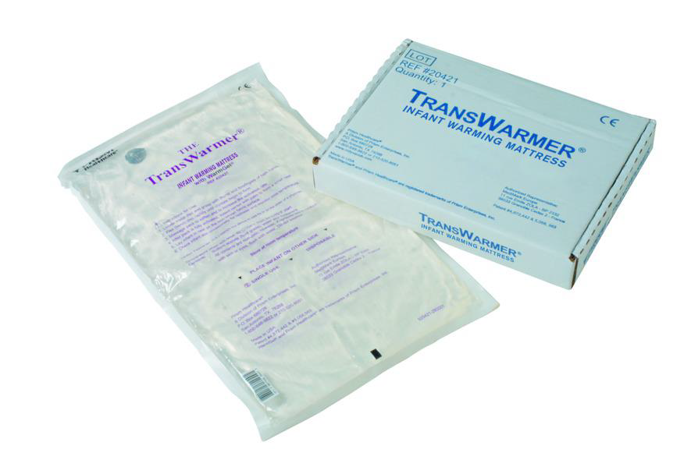
Transwarmer Infant Warming Mattress
The Transwarmer Infant warming Mattress is a self-warming heat pad that reaches 40ºC in one minute and is designed for use with young infants and neonates where there is a risk of hypothermia.
A pilot was developed and The Transwarmer mattress was stocked on all Operations Officers (OO) and Critical Care (CC) resources. Using the PDSA model, a review of its effectiveness was then undertaken.

Slide 7
Review, Learn and Improve
Every week the Trust is called to attend in excess of 15,000 patients and occasionally, something goes wrong or an unexpected event happens that leads to the patient experiencing a level of harm.
The Trust actively encourages all staff to report any incidents on the web based reporting system, DATIX. Reporting incidents means that the Trust can review its processes to ensure patient and staff safety is top of the agenda.
The focus of SWASTs Review, Learn and Improve process is to learn from incidents, improve practice and prevent future incidents from happening.
In 2020 the Trust received a number of RLI opportunities from Maternity Units relating to newborns becoming hypothermic following birth in the pre-hospital setting and arriving at hospital with core temperatures below the recommended range.
A data review was completed for the time period 01/02/2020 and 31/05/2020 where there were 22 incidents identified as potentially requiring further clinical interventions.
Of these incidents, the temperature ranged between 34.7- 36.6 °C, of which 50% of these were below the range recommended by the Resuscitation Council UK (36.5-37.5°C)¹
These findings further supported the findings of the Transwarmer mattress pilot.

Slide 8
Quality Improvement Collaboration
In response to the RLI incidents, a quality Improvement collaborative was set up consisting of Midwives, a Consultant Neonatologist and the SWAST Clinical Lead for maternity.
Using a QI approach and methodology, the team reviewed the RLIs and identified areas of learning and improvement.
Although the Transwarmer mattress was being piloted on OO and CC resources, these vehicles were not available or allocated on two of these incidents and therefore the mattress was not available to support the clinicians with thermal care.
A recommendation was made to SWAST Directors for the Transwarmer mattress to be stocked on every vehicle across the Trust. This was supported and in February 2021, all vehicles within SWAST were stocked with a Transwarmer mattress.

Slide 9
Successful Feedback
.
Whilst it is too early to review the full effectiveness of this service development the team have received the following positive feedback from maternity units who were keen to share and pass on their praise to SWAST staff:
A crew took a newborn’s temperature at birth which was recorded as 35.9°c. On arrival at the maternity unit, the midwife noted that the newborn was well wrapped and wearing a hat. The newborn’s temperature had improved to 36.7°c due to the crews constant monitoring and thermal management
A crew arrived on scene approximately 2-5 minutes after the birth and found the newborn to be uncovered. They immediately dried and placed the newborn skin to skin and the temperature was recorded as being 35.2° c. The crew monitored the newborn’s temperature and recorded it at 36.4° c twenty minutes later. On arrival at hospital the midwife checked the temperature and found that it had risen to 36.7° c due to the staff’s thermal management
A maternity unit reported that there has been a positive change and improvement in documentation and wished to highlight and praise this good practice

Slide 10
What else and What’s Next?
Pre-term face masks- The European Resuscitation Council and the revised JRCALC Newborn Life Support guidance due out soon both recommend ensuring that pre-term face masks are available for NLS- SWAST are now stocking them in all maternity bags
PROMPT booklets- Practical Obstetric Multi-Professional Training (PROMPT) has been offered to staff as a continuous professional development (CPD) opportunity for many years and has always received a lot of positive feedback. A PROMPT algorithm booklet was developed and the Trust have now introduced these to all maternity bags to support staff on scene
Cuddle pockets- Consideration of stocking these on all vehicles for the conveyance of stillborn premature babies ensuring more dignified and compassionate bereavement support and care
Adopt the MEWS and NEWTT tools- Recognising the deterioration of women and babies
Electronic Patient Care Records – upgrade to enable a new record to be opened for the newborn which can then be completed alongside the mother’s

Slide 11
References
Guidelines: Resuscitation and support of transition of babies at birth (RCUK)
Interventions to prevent hypothermia at birth in preterm and/or low birth weight infants (nih.gov

